Slide 1
INTRODUCTION
Dr Moses Ngari
Preparation and instruction by
Moses Ngari, Osman Abdullahi, Ken Mwai & Mark Otiende
March 15th – 19th, 2021

Slide 2
Outline of the course
Each day has a theme
Short presentations
(usually 30 but no more than 1 hour)
given the compressed nature of the presentations note questions for practical and review sessions
notes in folder are more comprehensive explanations of presentations
Practical sessions
Reviews to sum up and consolidate main themes

Slide 3
Aims of course
Enable researchers to better apply statistical techniques
Introduce statistical concepts dealing with descriptive statistics, comparisons and statistical modelling
Introduce and extend participants knowledge of and expertise with the R programming to do statistical analyses

Slide 4
What is research?

Slide 5


Slide 6
“the systematic investigation into and study of materials and sources in order to establish facts and reach new conclusions.”
"research is a process of steps used to collect and analyze information to increase our understanding of a topic or issue"

Slide 7
Research Methods
Research
Data collection methods (bias)
Establishing relationships (statistical techniques) (Validity)
Evaluating the accuracy of the results obtained (Reliability).

Slide 8
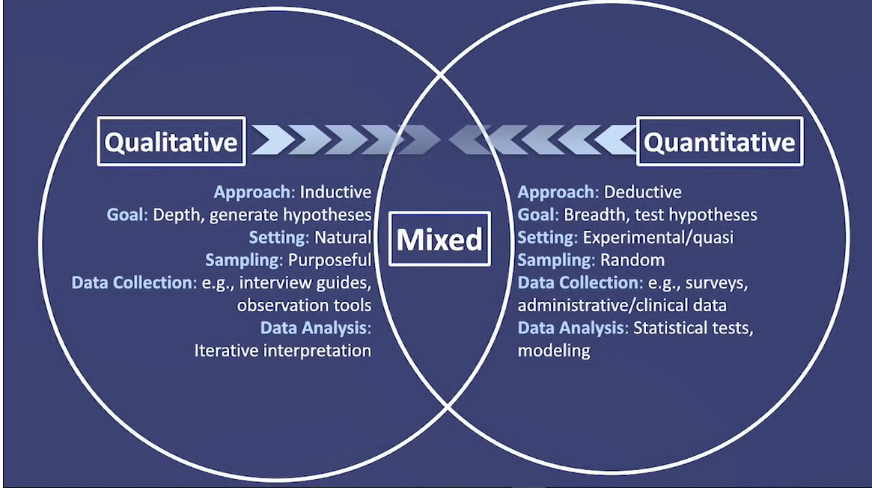
Research Methods

Slide 9
Qualitative Vs Quantitative
Qualitative
Quantitative
Understanding
Interview/observation
Discovering frameworks
Textual (words)
Theory generating
Quality of informant more important than sample size
Subjective
Embedded knowledge
Models of analysis: fidelity to text or words of interviewees
Survey/questionnaires
Existing frameworks
Numerical
Theory testing (experimental)
Sample size core issue in reliability of data
Model of analysis: parametric, non-parametric

Slide 10


Slide 11
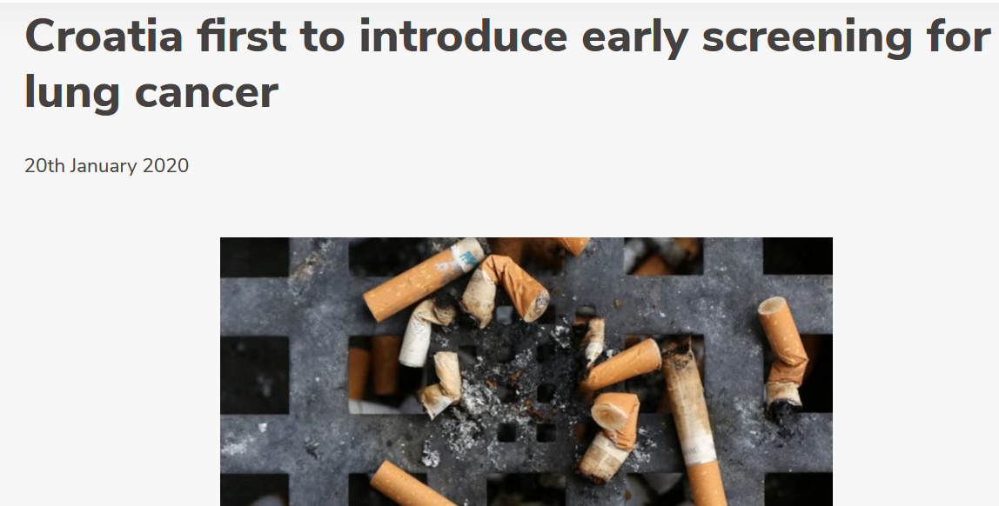

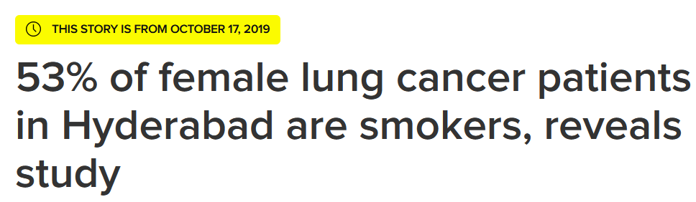

Slide 12
Are smokers more likely to develop lung cancer than non-smokers?

Slide 13
Exposure and outcome
The exposures and outcomes of interest are specific to study hypotheses
Should always be clearly defined before the study starts
Type of outcome determines the analysis that will be used.

Slide 14
Outcome
The outcome of a study is a broad term for any defined disease, state of health, health-related event or death.
An outcome is the result of an experiment or other situation involving uncertainty.
Its the focus of your attention – seeking to understand its occurrence and variation
In some studies, there may be multiple outcomes.

Slide 15
Exposure
The exposure of interest may be associated with either an increased or a decreased occurrence of disease or other specified health outcome.
May relate to the environment, or inborn or inherited characteristics

Slide 16
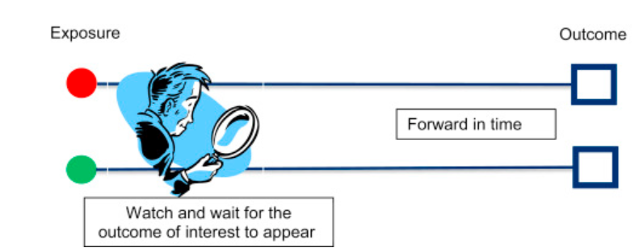

Slide 17
In the smoking example, what is
Exposure?
Outcome?

Slide 18
In the smoking example, what is
Exposure?
Outcome?
Smoking status
Diagnosis of Lung Cancer

Slide 19
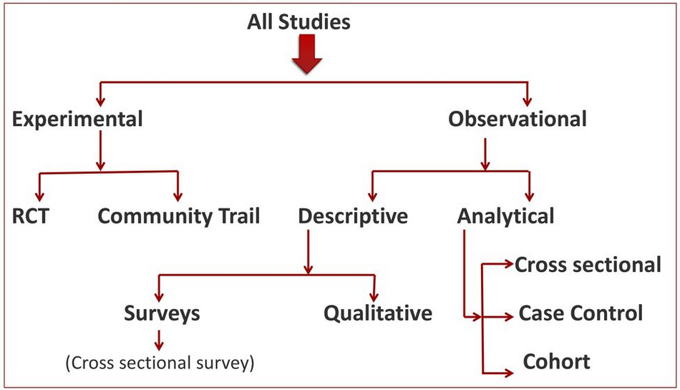

Slide 20
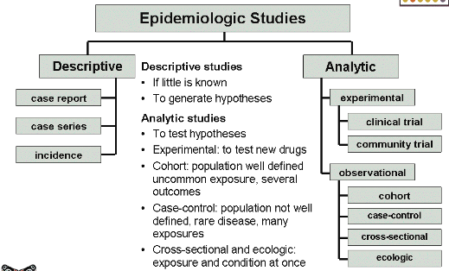

Slide 21
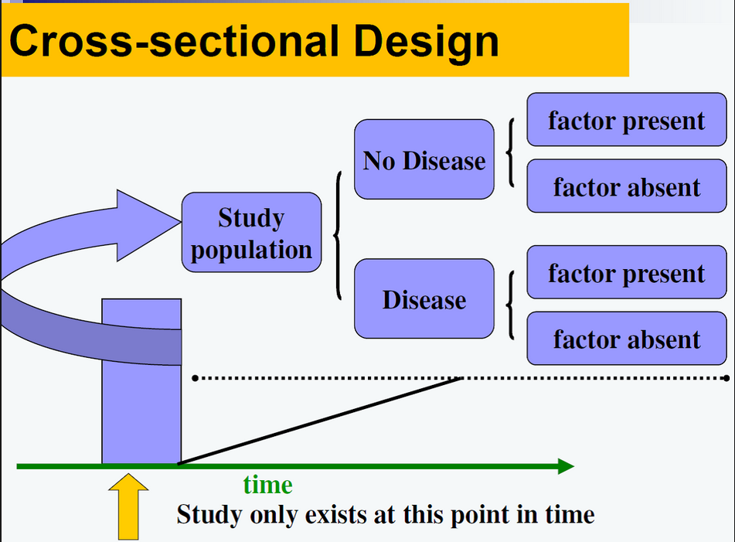

Slide 22
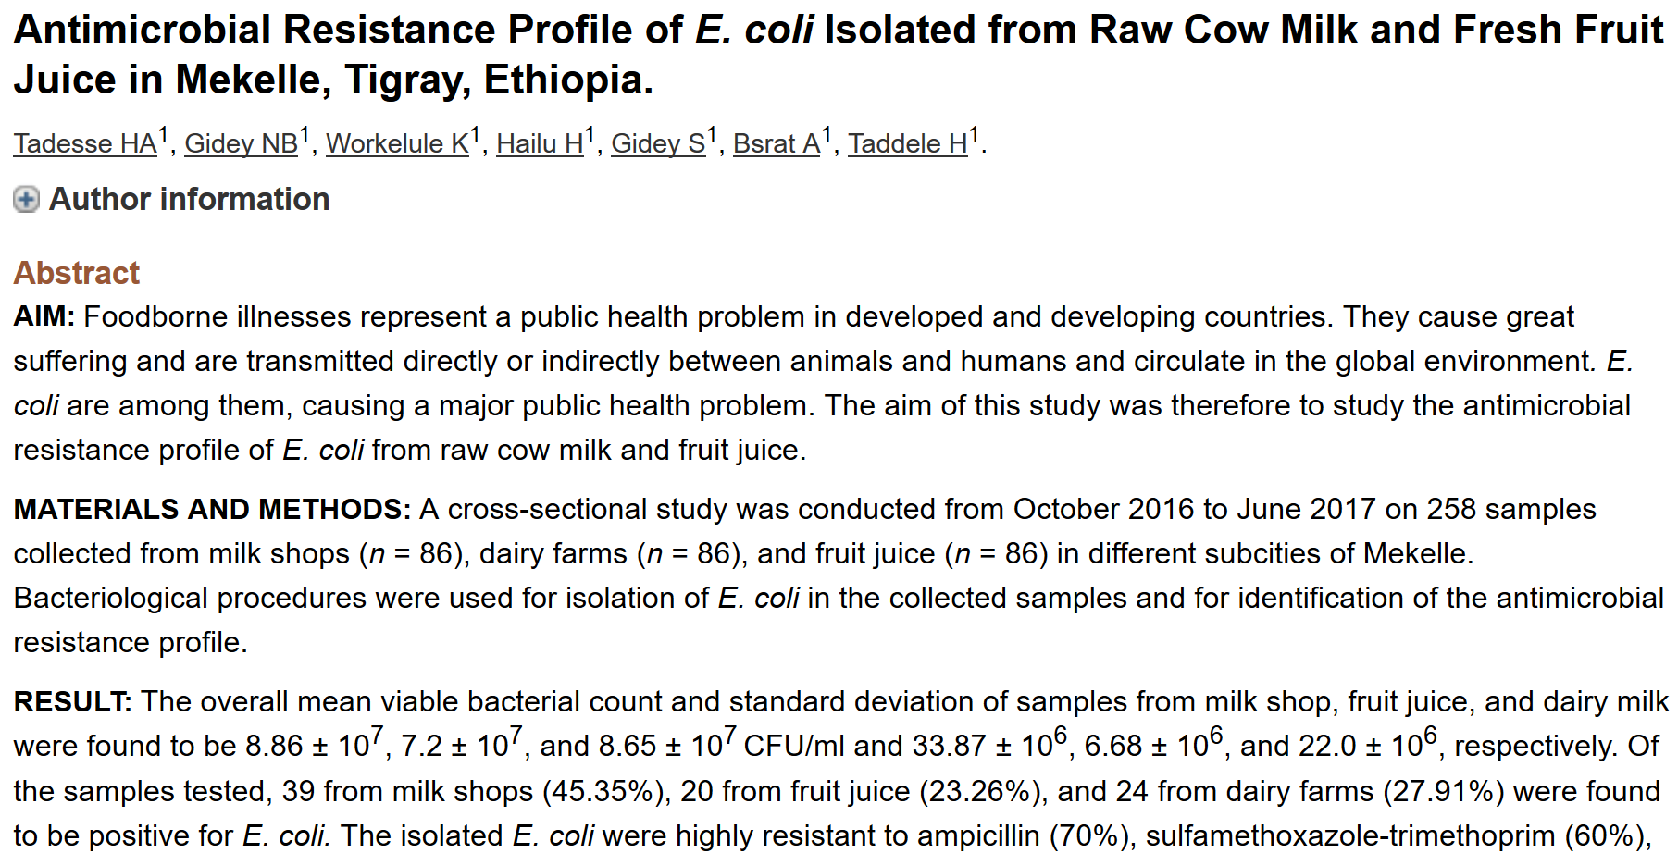

Slide 23
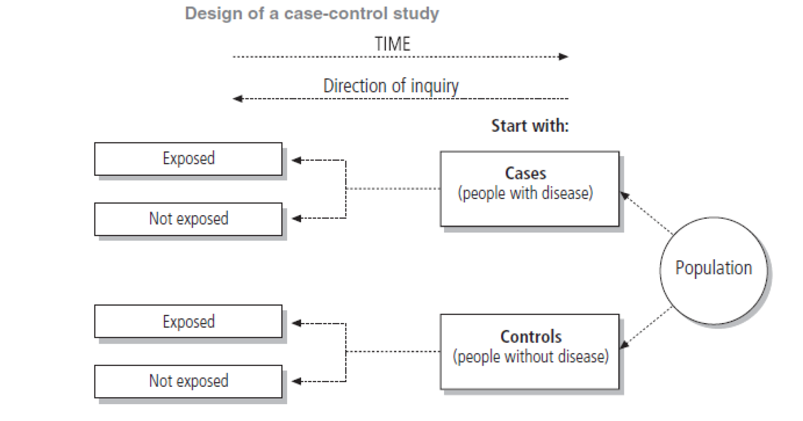
Case-control studies

Slide 24
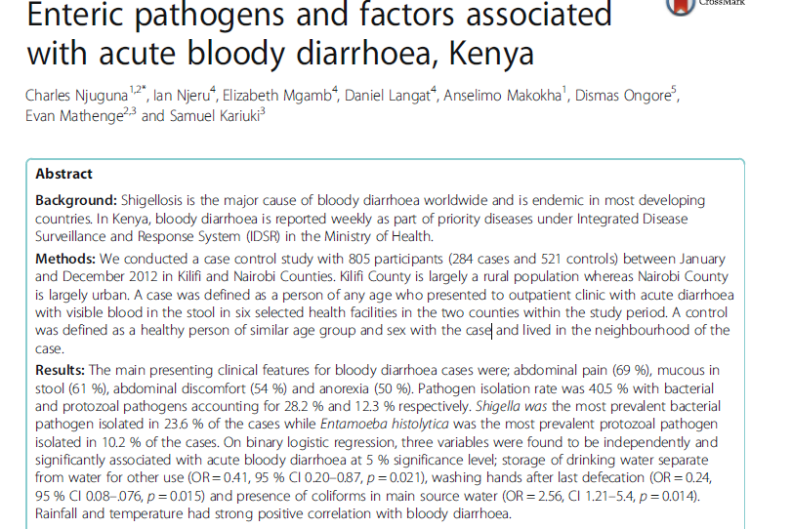

Slide 25
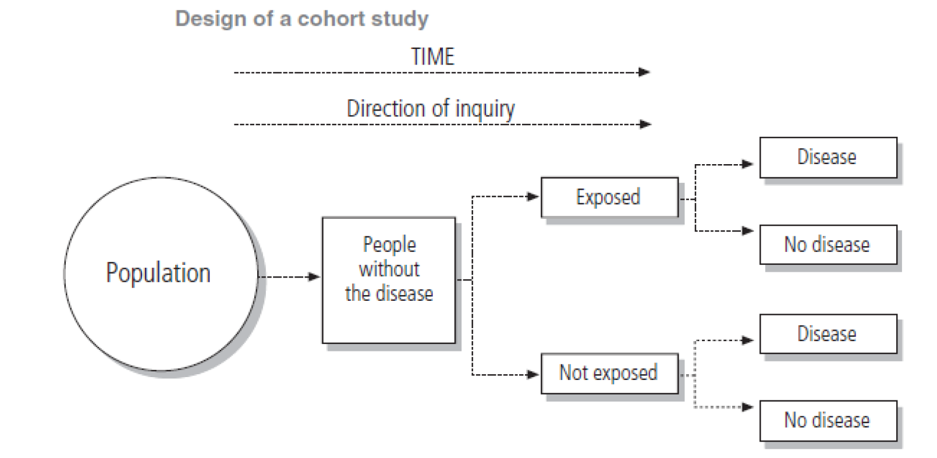
Cohort study

Slide 26
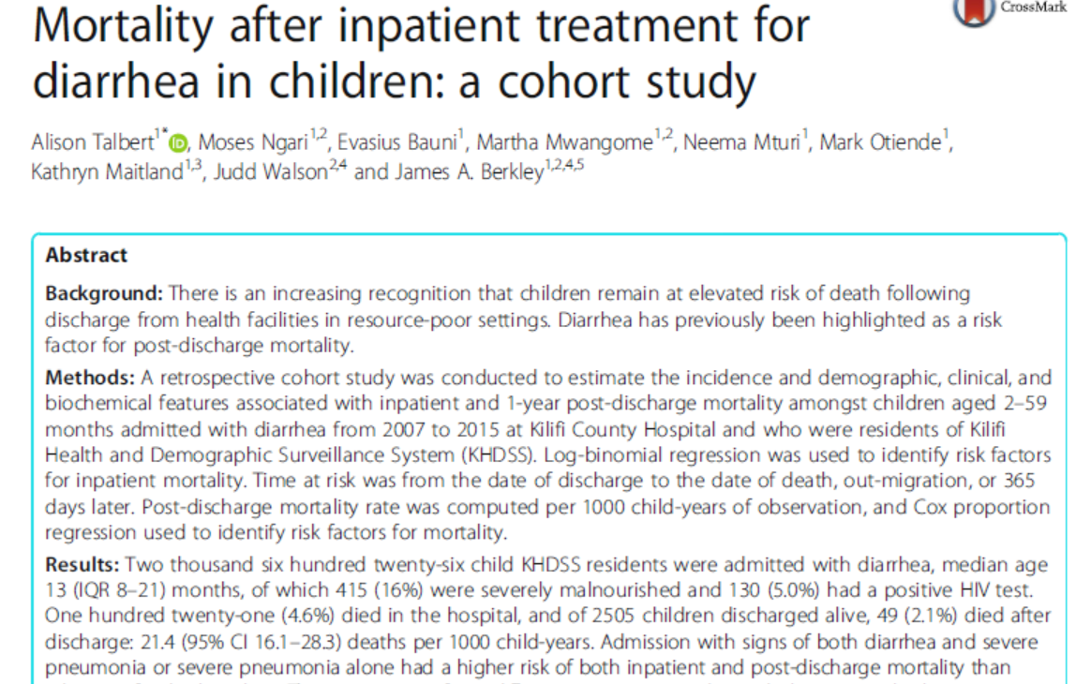

Slide 27
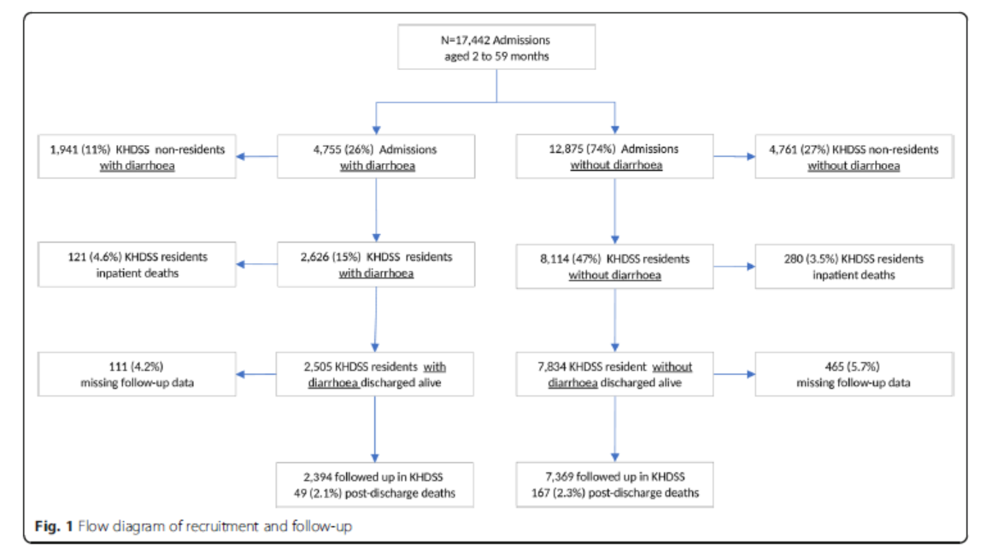

Slide 28
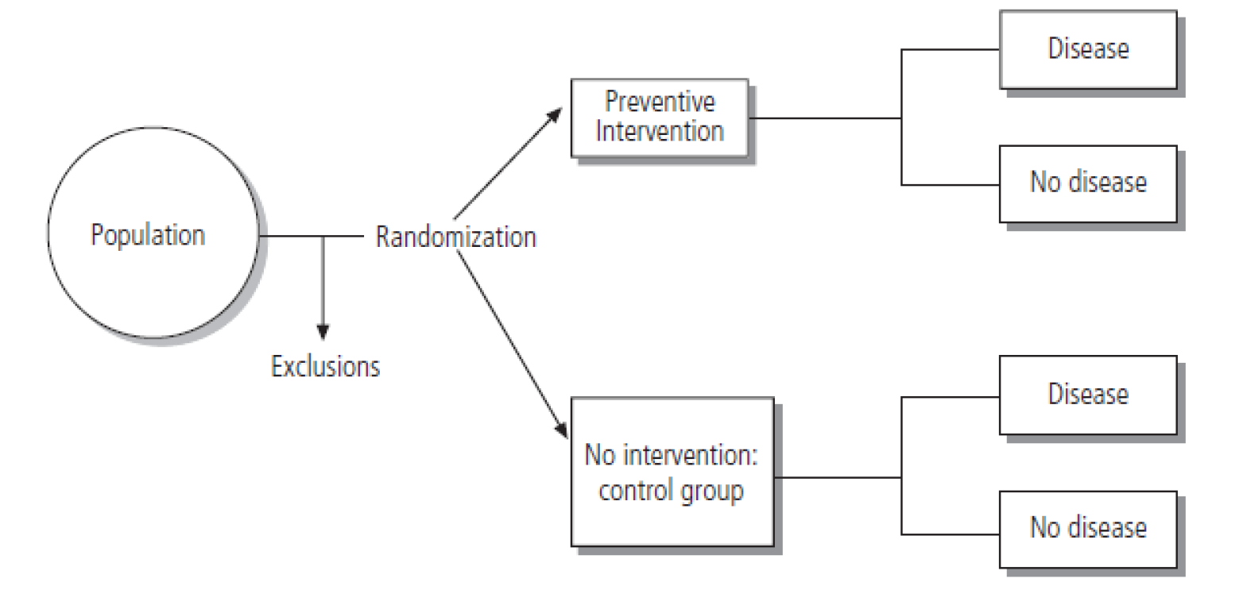
Randomized Clinical Trial

Slide 29
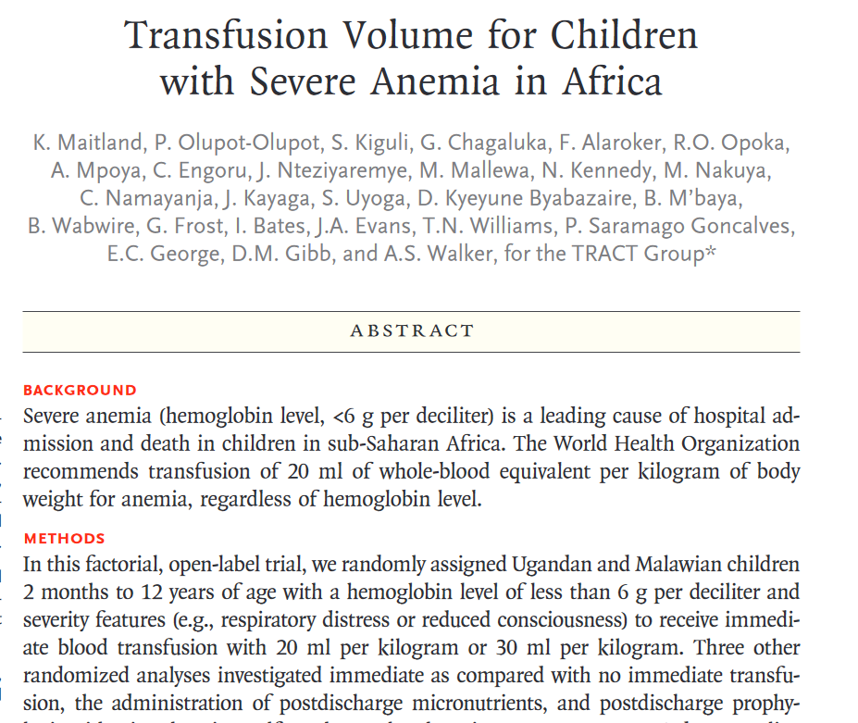

Slide 30
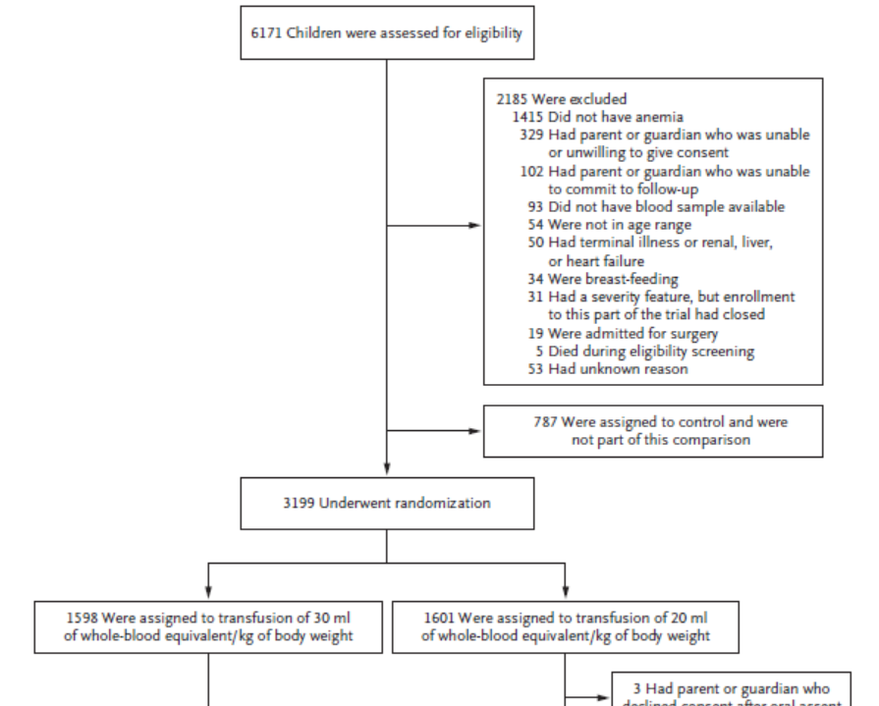

Slide 31
Develop
hypothesis
Descriptive Studies
Investigate it’s
relationship to
outcomes
Case-control Studies
Increasing Knowledge of
Disease/Exposure
Define it’s meaning
with exposures
Cohort Studies
Test link
experimentally
Clinical trials
Notes:
To further illustrate, if one seeks to identify the etiologic factors (e.g. causal factors) behind an outcome (e.g. an MI), then each step in the epidemiologic framework provides new and important information.
Descriptive studies are useful for identifying hypotheses to test in analytic studies. Case-control studies are then usually applied to evaluate if the hypothesized factor is related to the outcome of interest. Subsequently, cohort or longitudinal studies are applied to further define the importance of exposure to the causal agent for the development of the outcome.

Slide 32
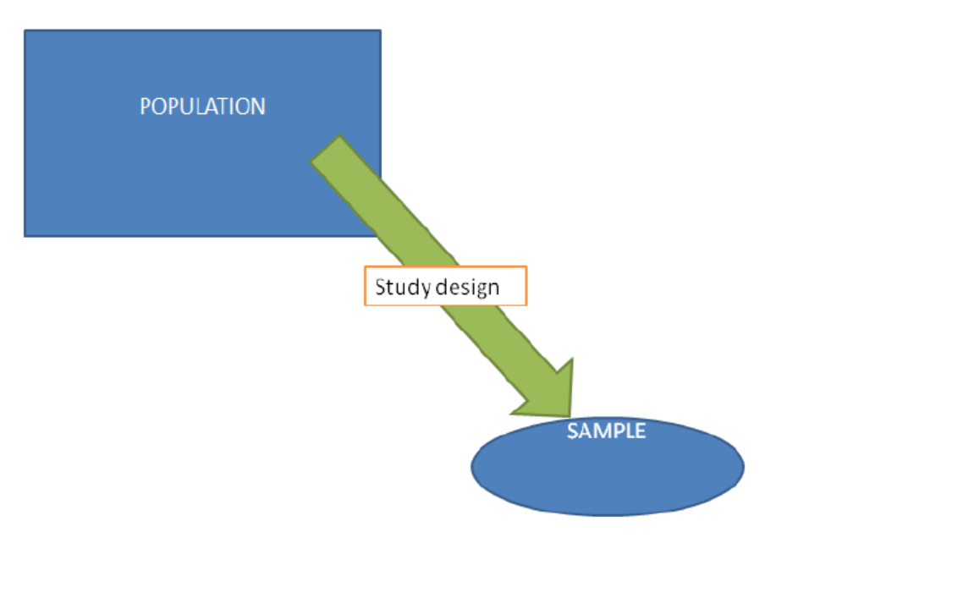

Slide 33
Exposure & outcome measurements
Need to describe your population & sample
Measure the exposure: smoking or not smoking
Measure the outcome: diagnosis of lung cancer
These can be categorical or quantitative

Slide 34
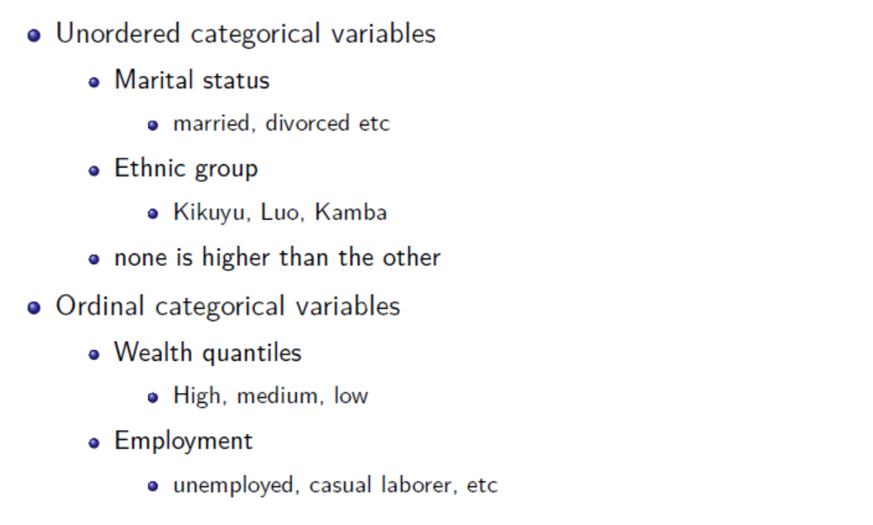
Categorical variables

Slide 35
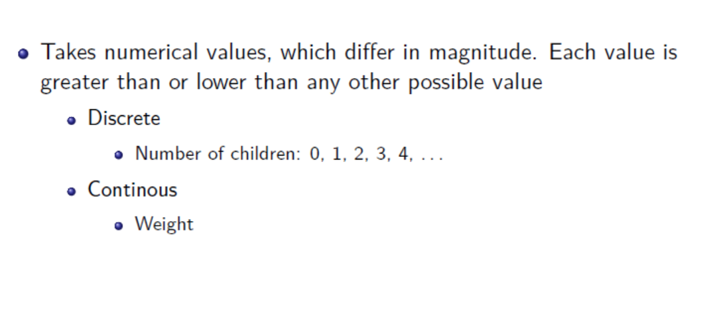
Quantitative variable

Slide 36
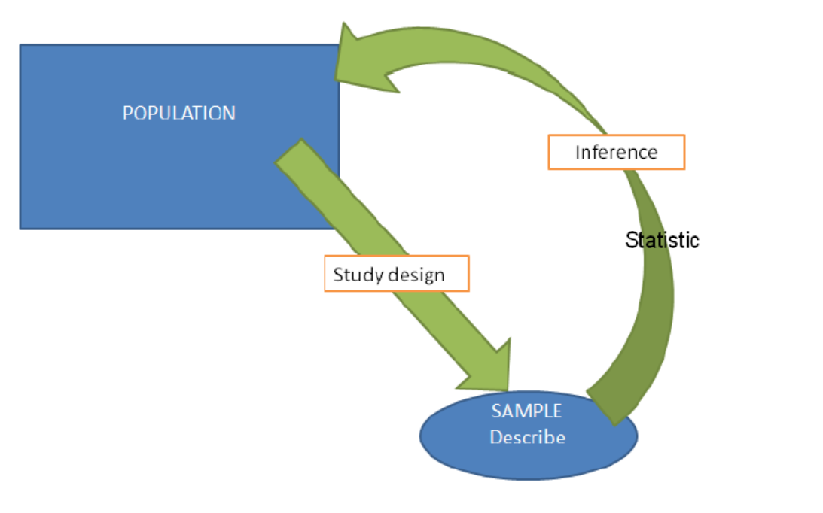

Slide 37
Statistics
Allow us to use the sample to make inferences about the population from which it was derived. . . . . .
Statistics can be computed using different software:
R programming
SPSS
STATA
SAS

Slide 38
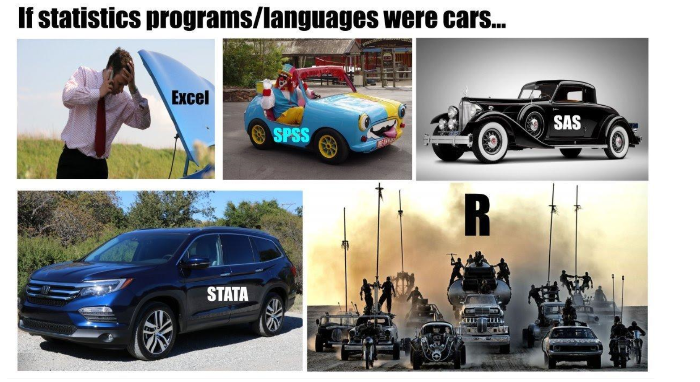

Slide 39


